Slide 1
Art & Design at the High School Level

Slide 3
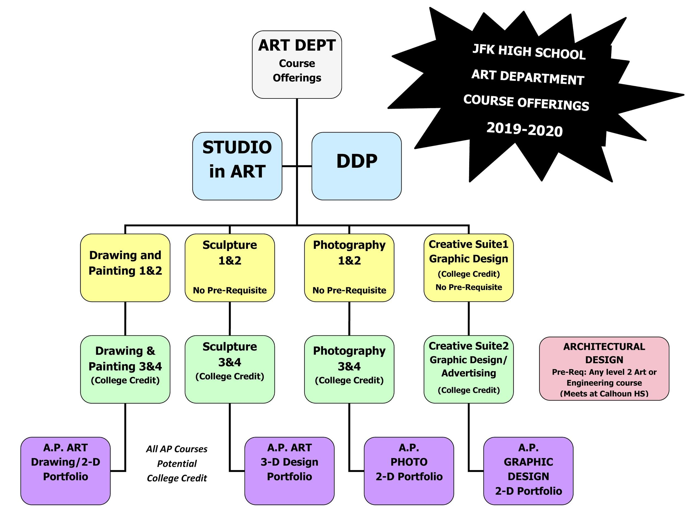

Slide 4
Drawing & Painting

Slide 5
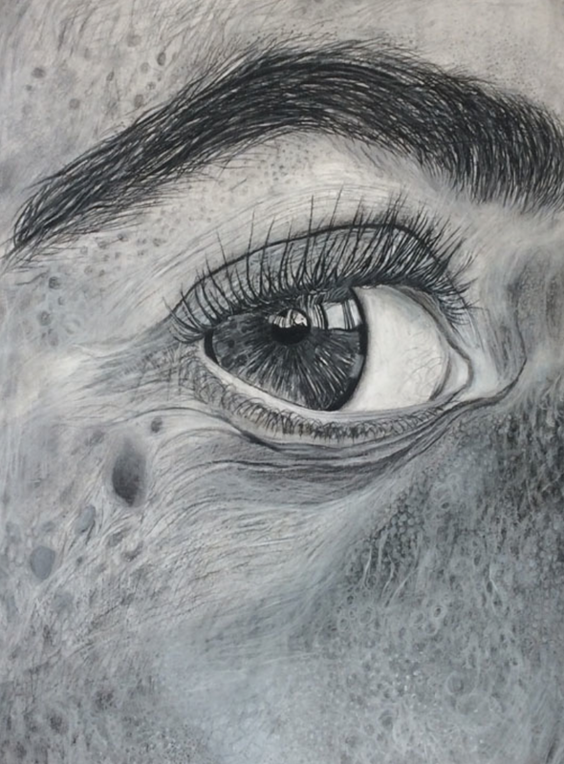

Slide 6
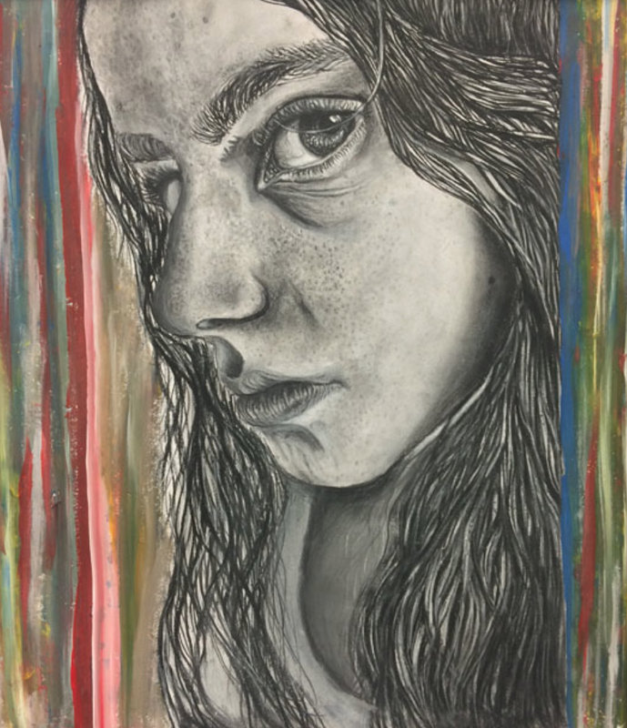

Slide 7
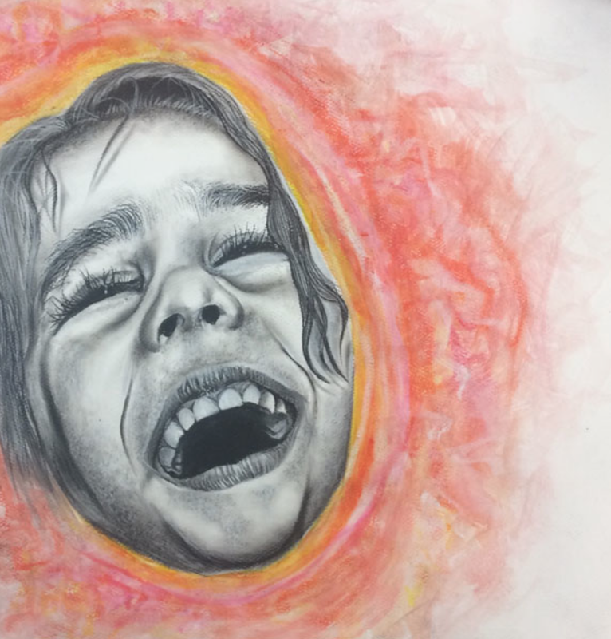
Paul Anagnostopoulos

Slide 8
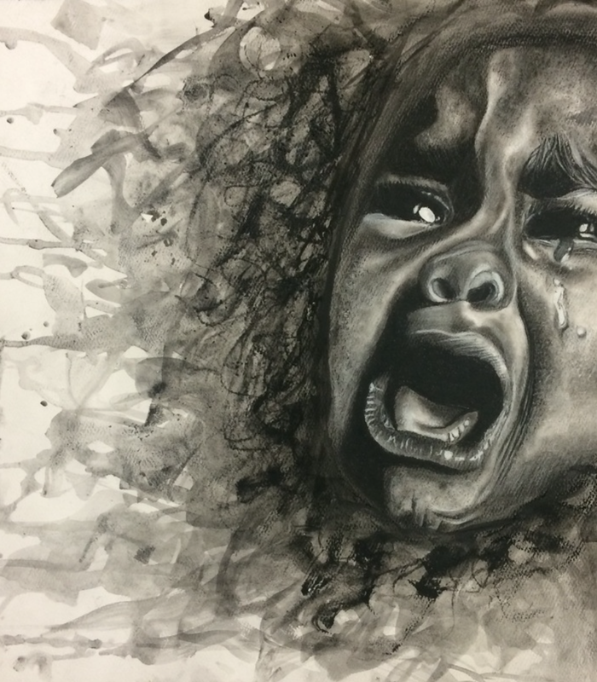

Slide 9
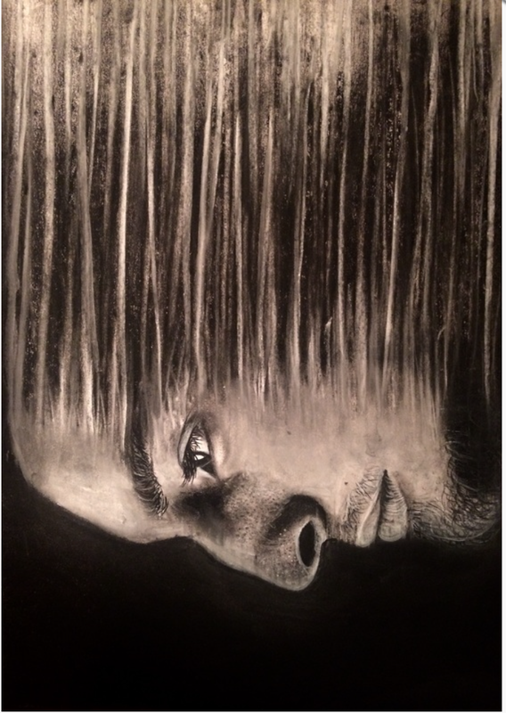

Slide 10
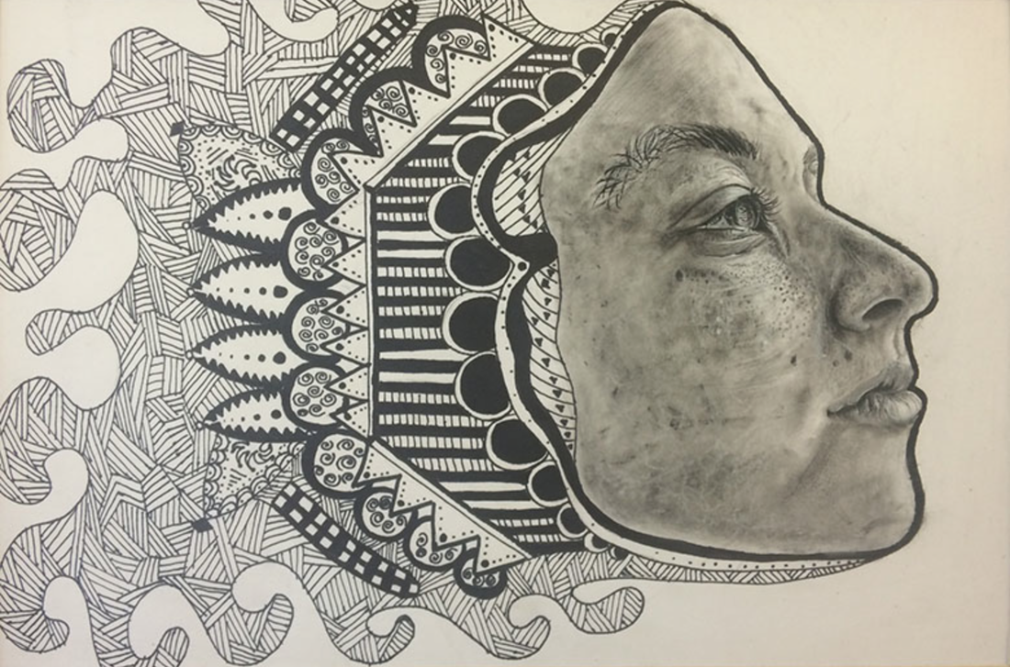

Slide 11
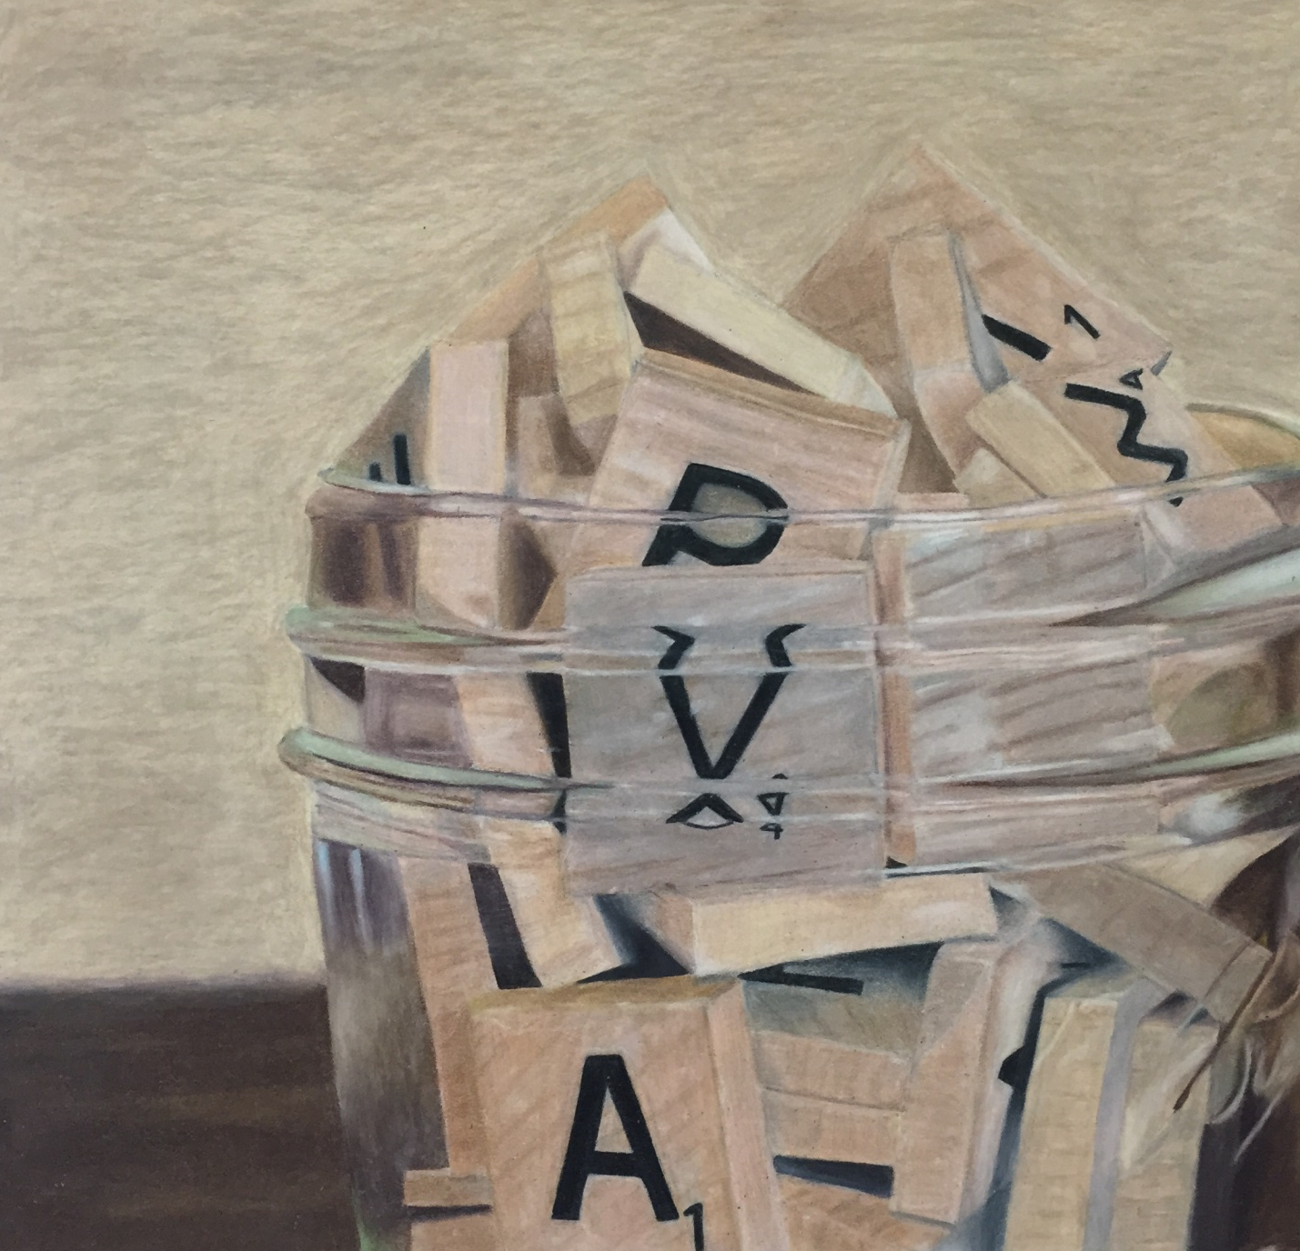
Objects behind Glass by Jessica Rosen
(colored pencil)

Slide 12
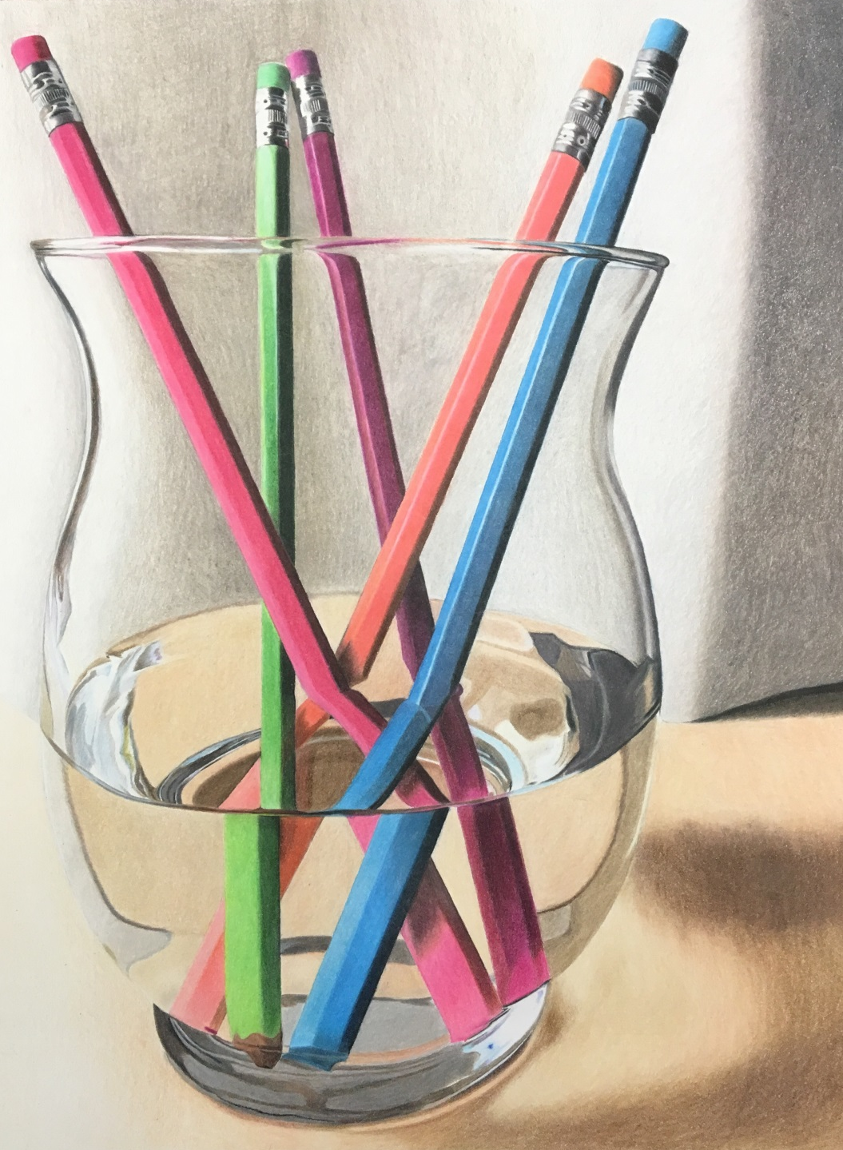
Objects behind Glass by Brianna Totino (colored pencil)

Slide 13
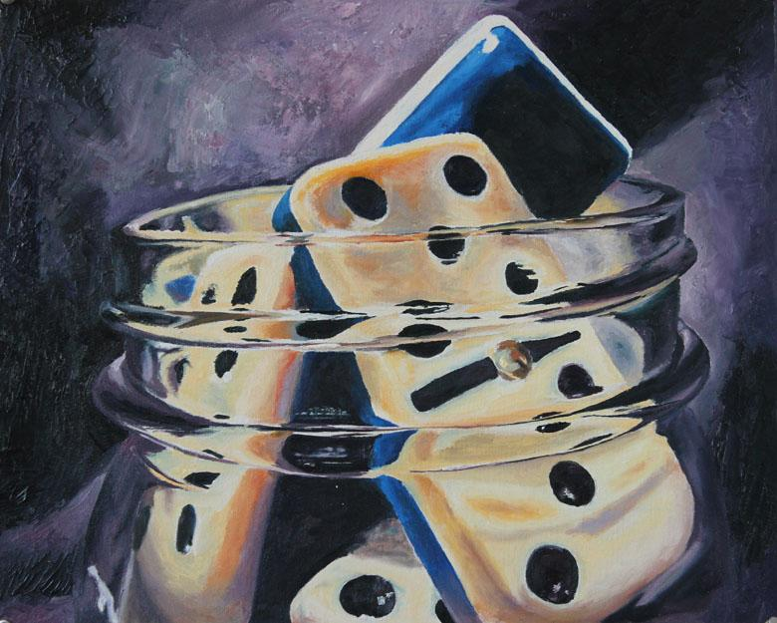
Objects behind Glass by Elizabeth Greene
(oil paint)

Slide 14
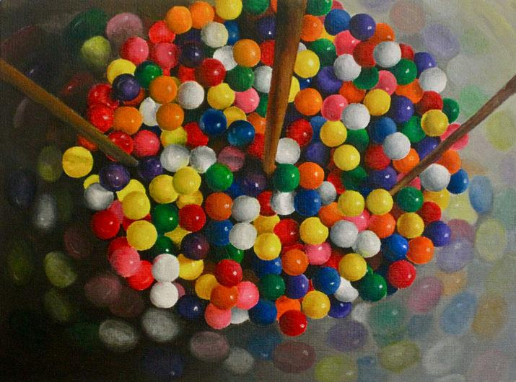
Objects behind Glass in acrylic paint

Slide 15
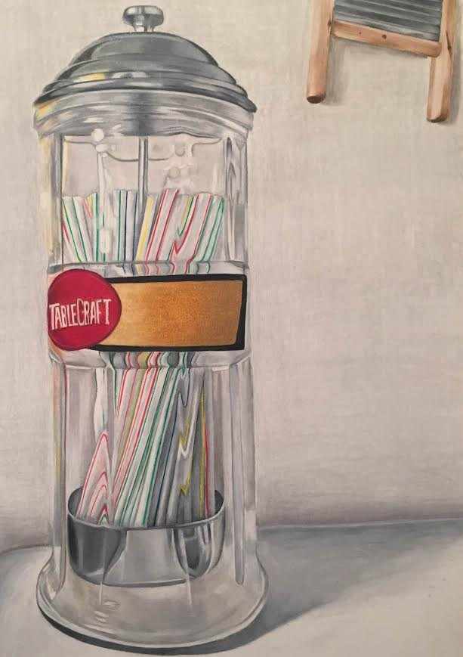
Objects behind Glass by Maggie Freed
(colored pencil)

Slide 16
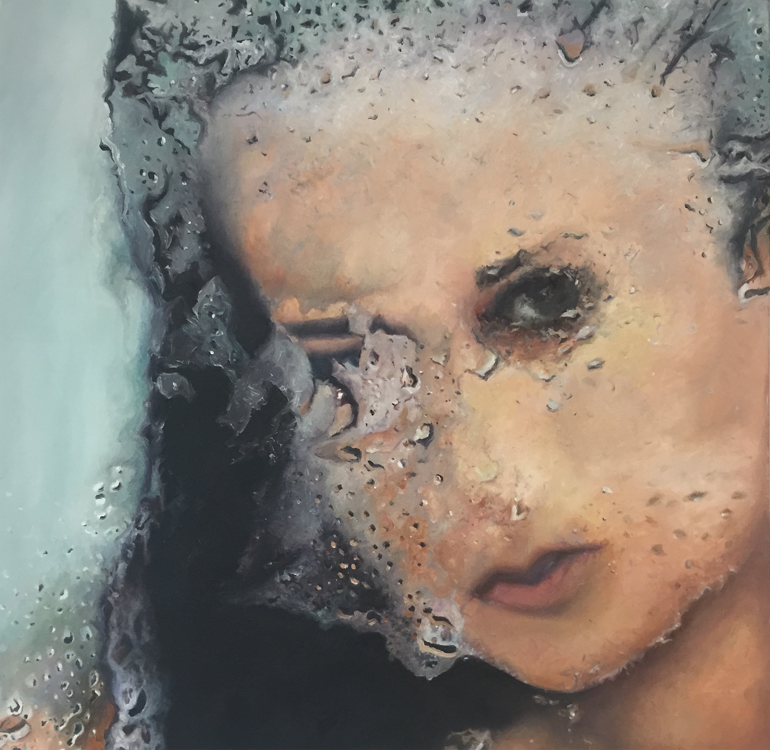
Person behind Glass by Haruka Kido
(oil paint)

Slide 17
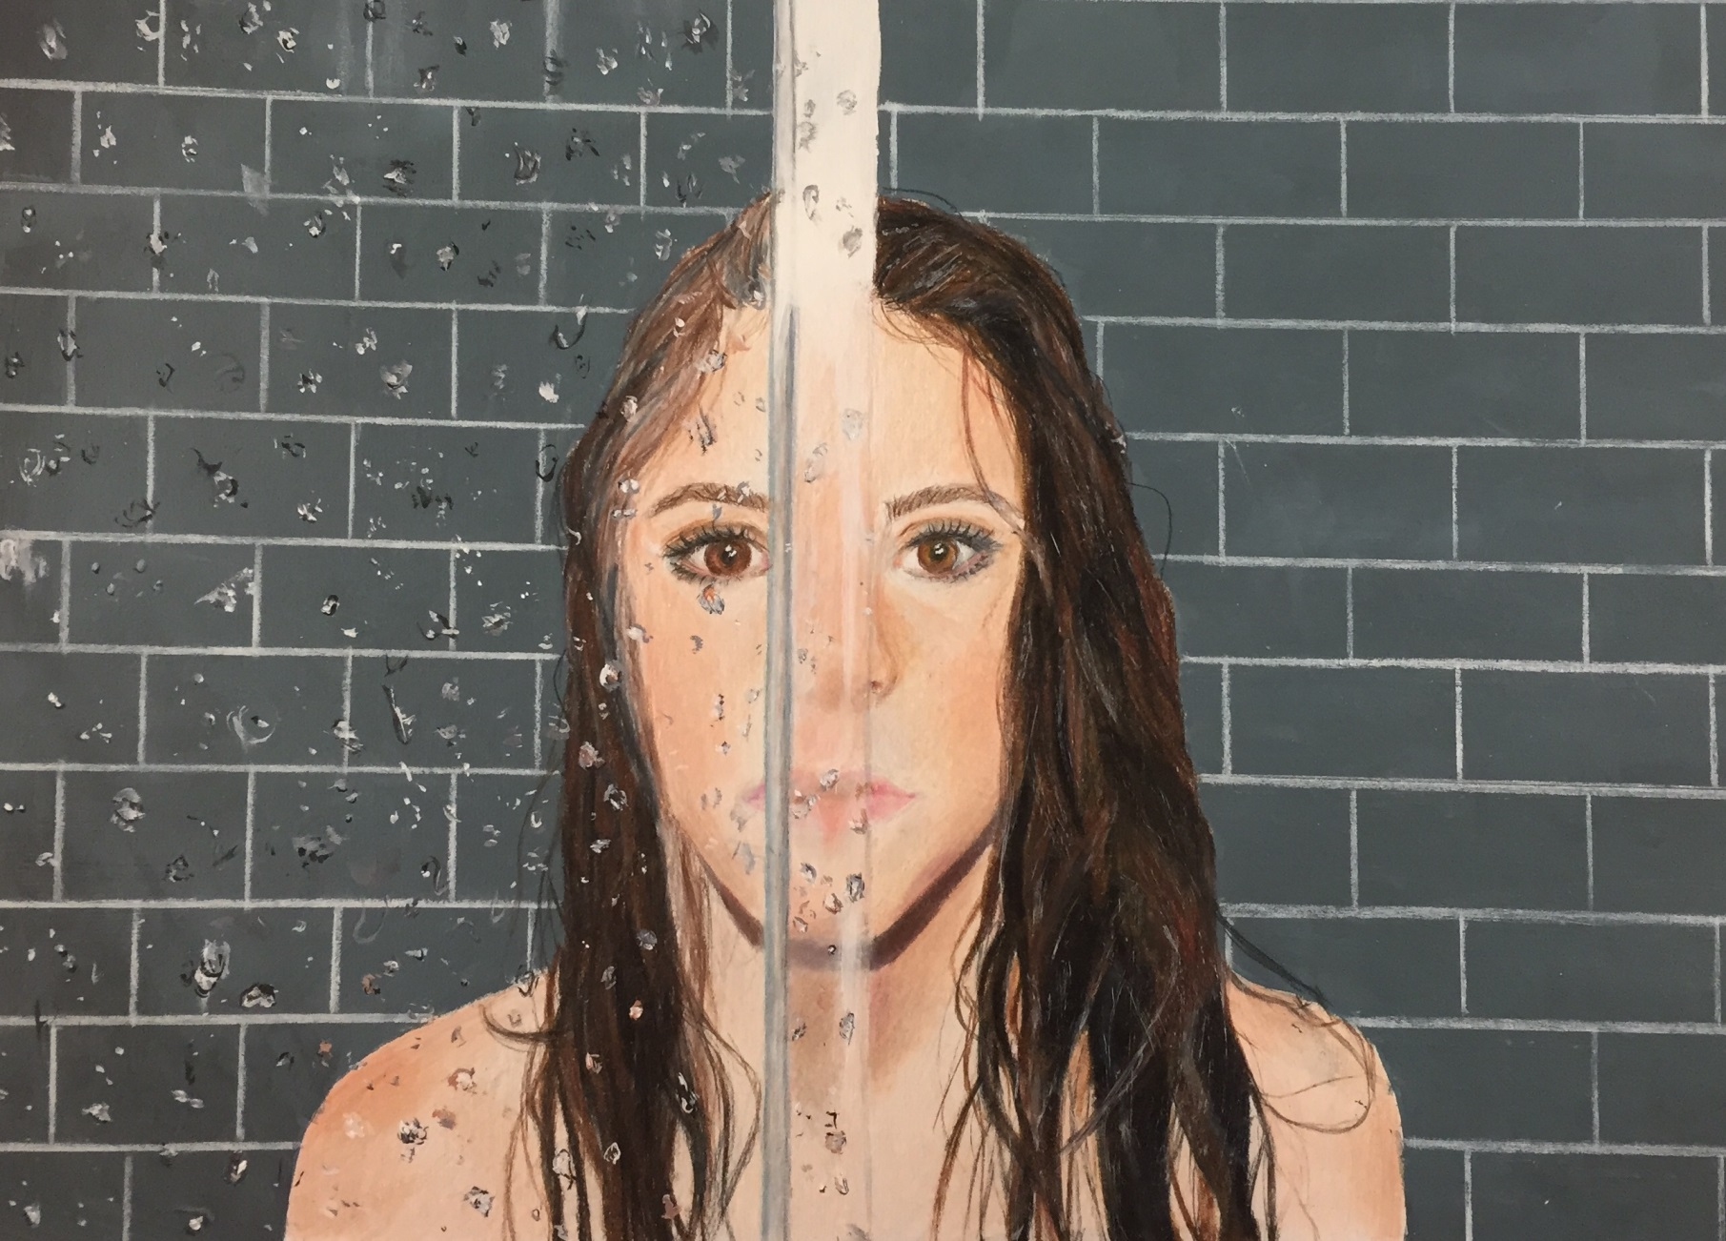
Person behind Glass by Cassandra Riordan
(colored pencil)

Slide 18
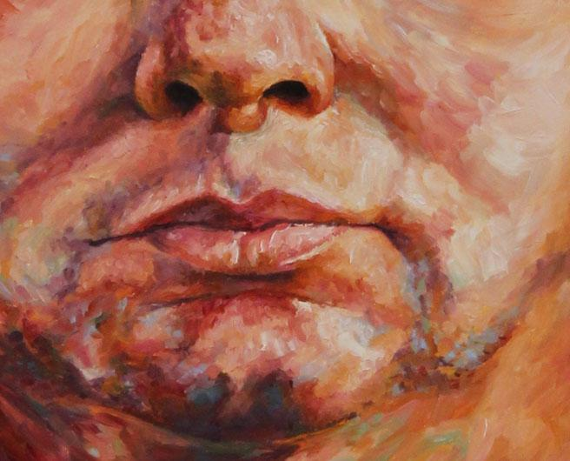

Slide 19
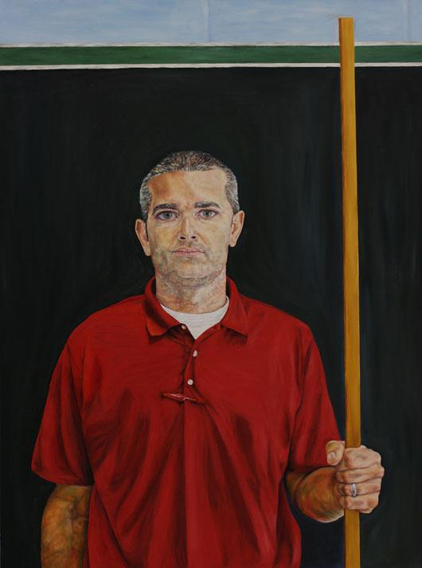
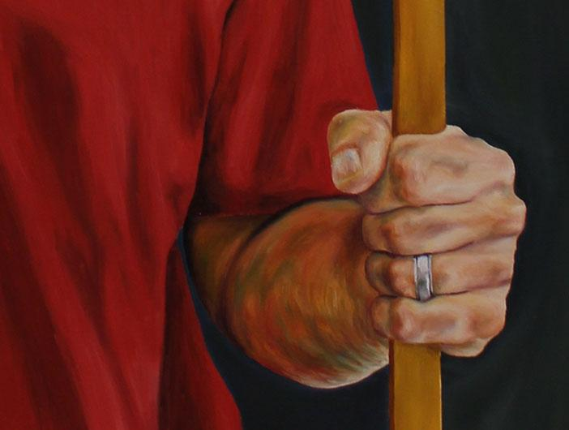
“Mr. Lella” inspired by Max Ferguson by Elizabeth Greene
(Oil Paint)

Slide 20
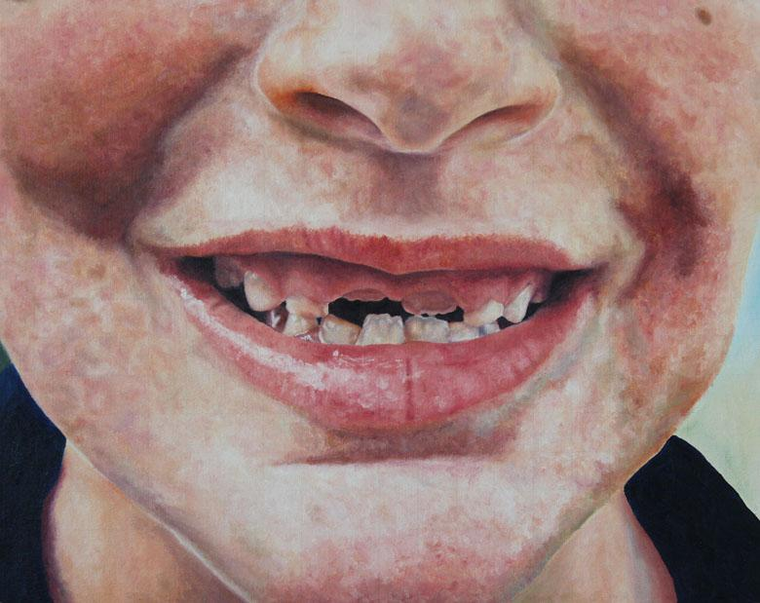
Family Portrait inspired by Chuck Close by Elizabeth Greene
(Oil Paint)

Slide 21
Family Portrait (inspired by Kehinde Wiley) by Alma Syla
(Charcoal)

Slide 22
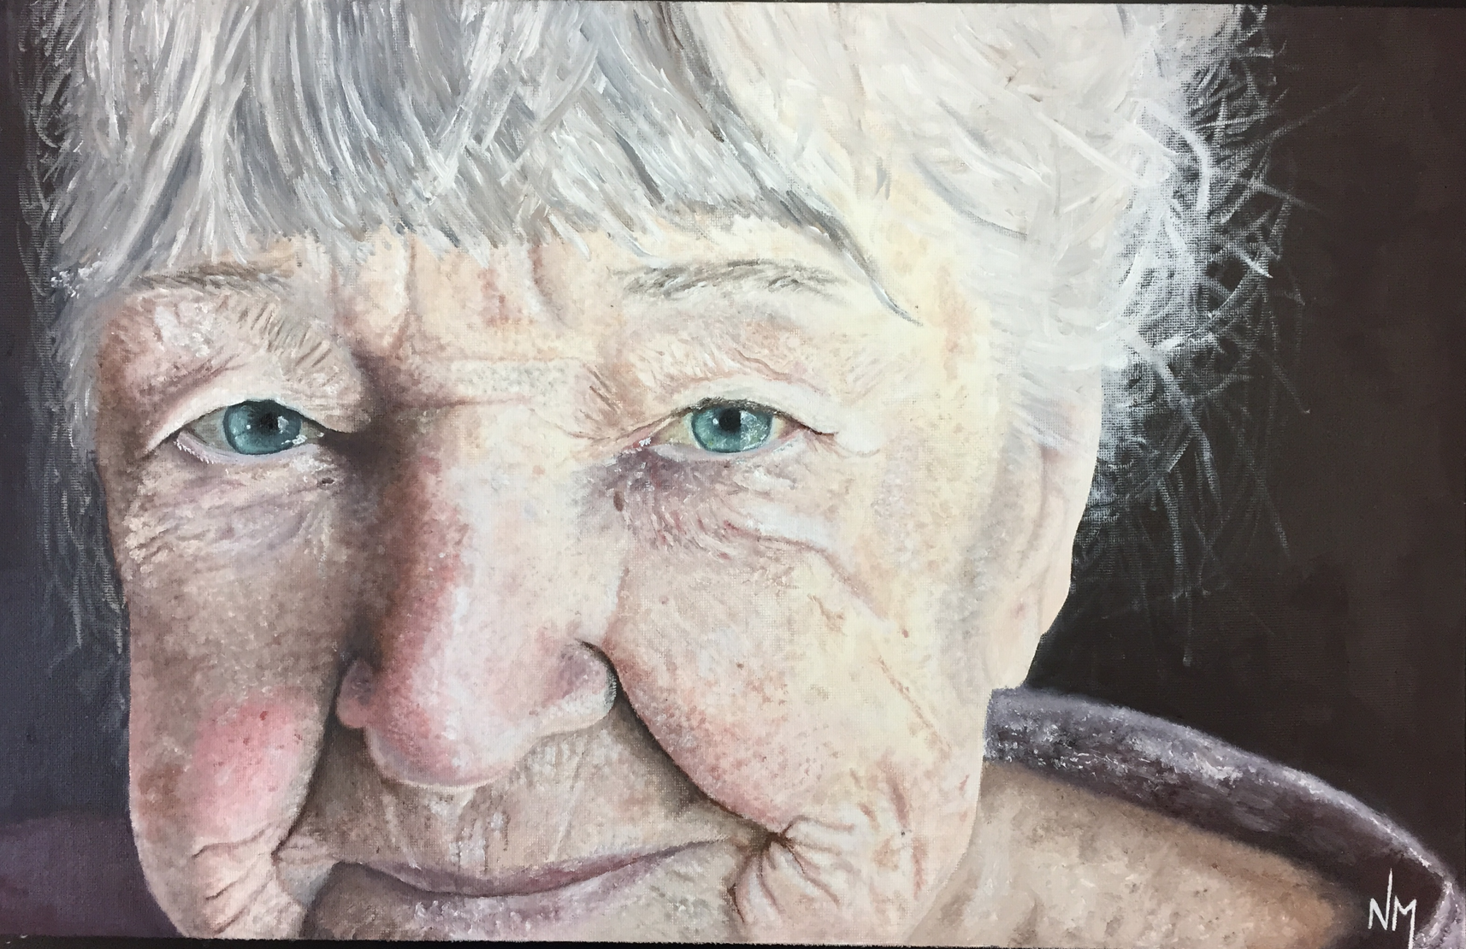
Family Portrait by Nicolette Macolino
(Oil Paint)

Slide 23
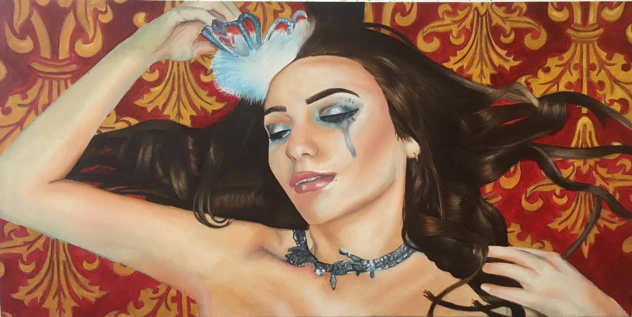
Self-Portrait by Victoria Sallows
(Oil Paint)

Slide 24
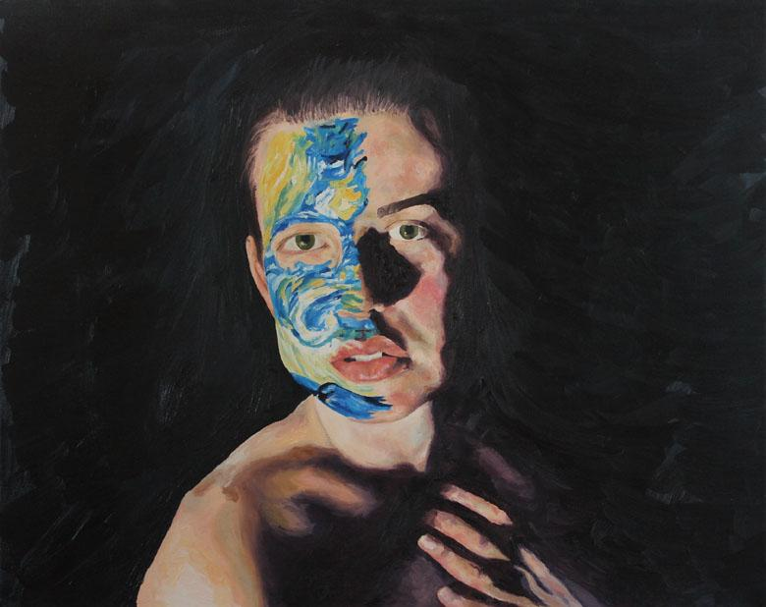
Self-Portrait by Elizabeth Greene
(Oil Paint)

Slide 25
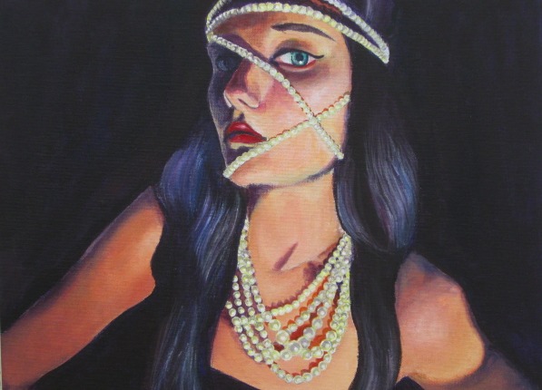
Self-Portrait by Hannah Palant
(Oil Paint)

Slide 26
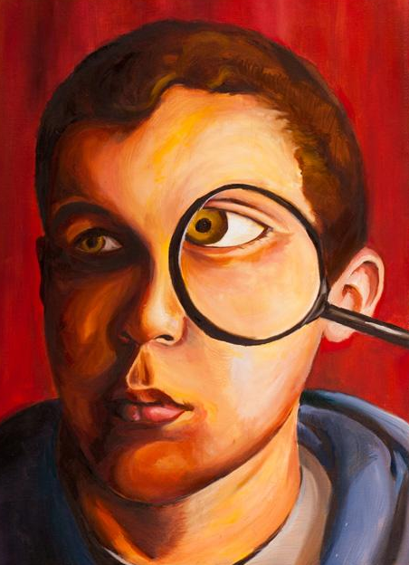
Self-Portrait by David Luft
(Oil Paint)

Slide 27
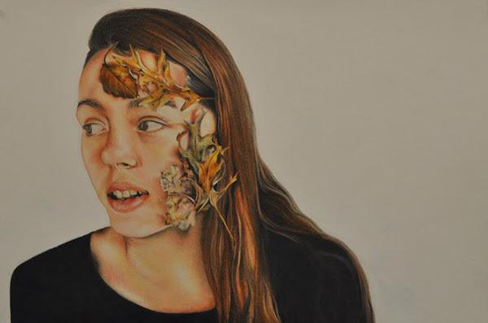
Self-Portrait by Rachel Martino
(colored pencil)

Slide 28
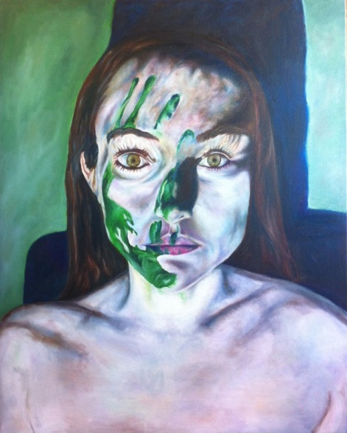
Self-Portrait by Amanda Knee
(oil paint)

Slide 29
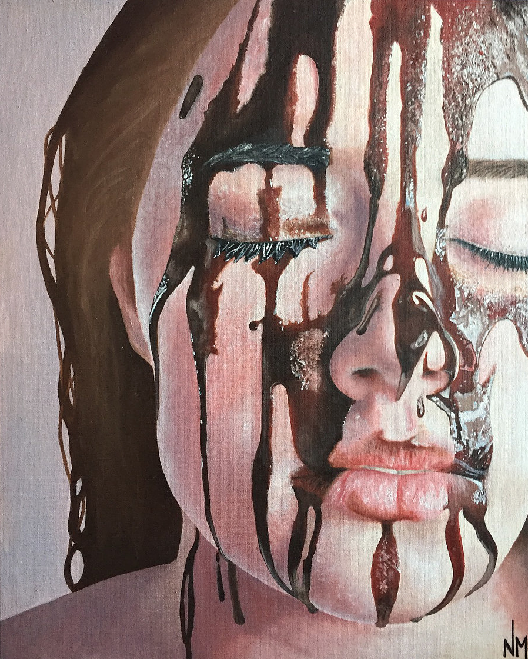
Self-Portrait by Nicolette Macolino
(oil paint)

Slide 30
Photography

Slide 31
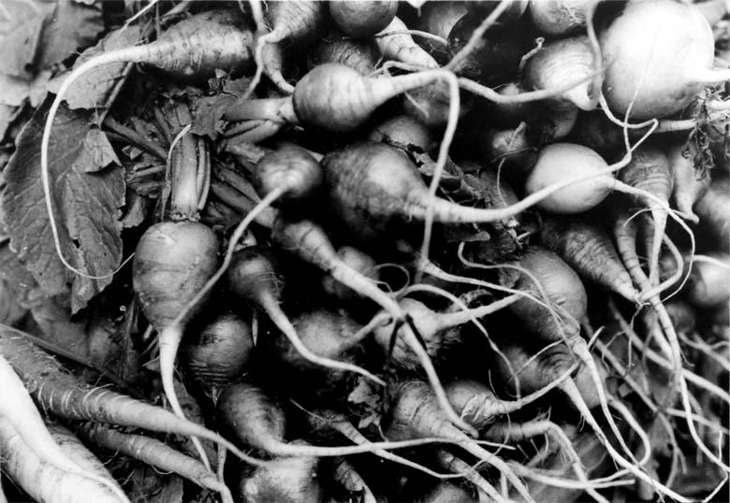

Slide 32
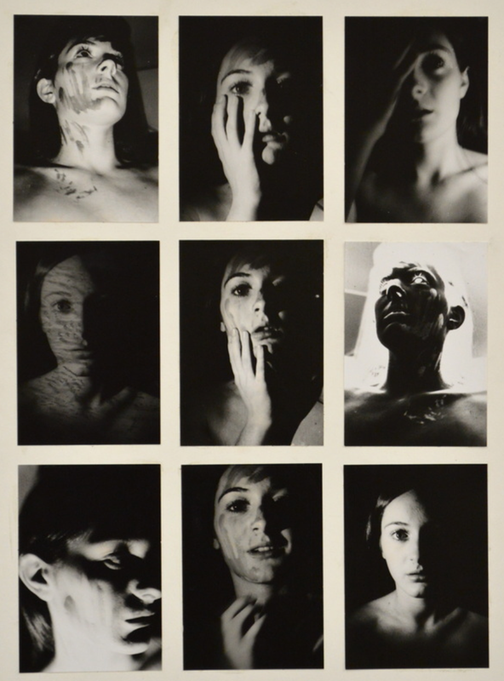

Slide 33
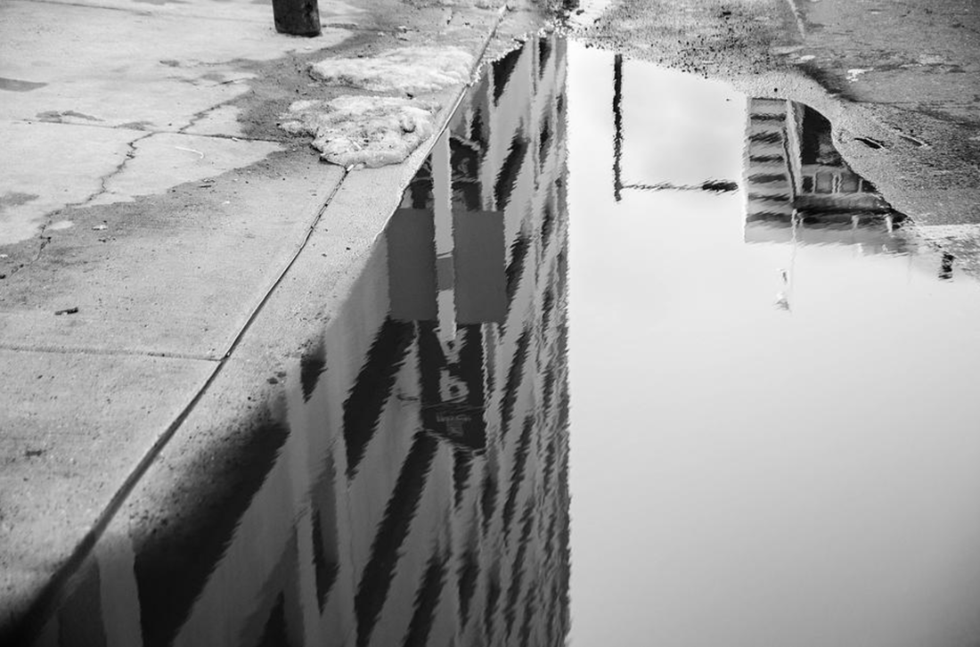

Slide 34
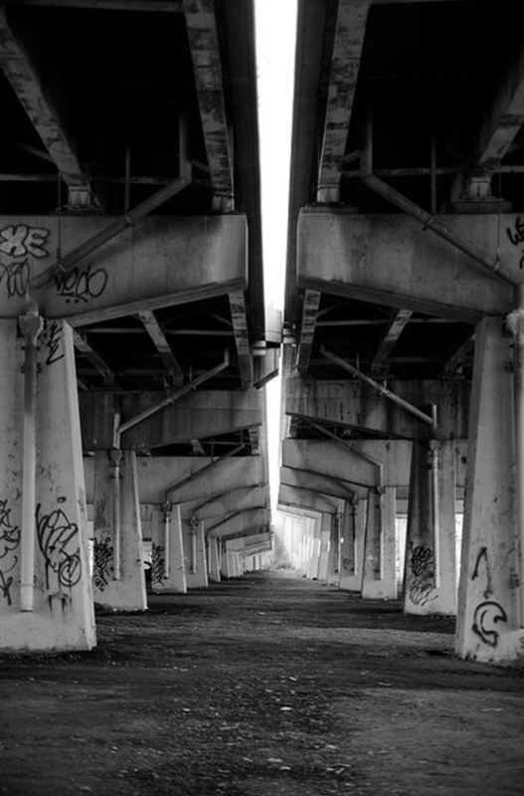

Slide 35
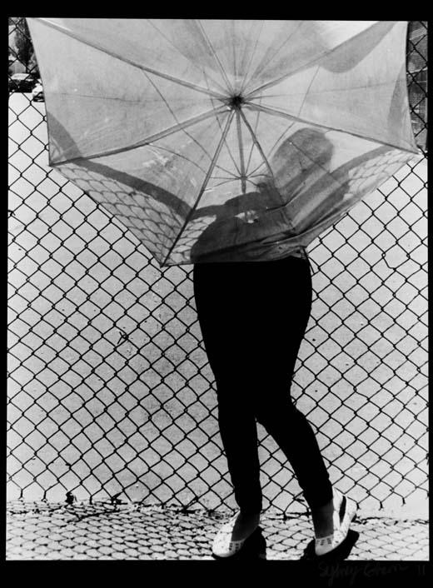

Slide 38
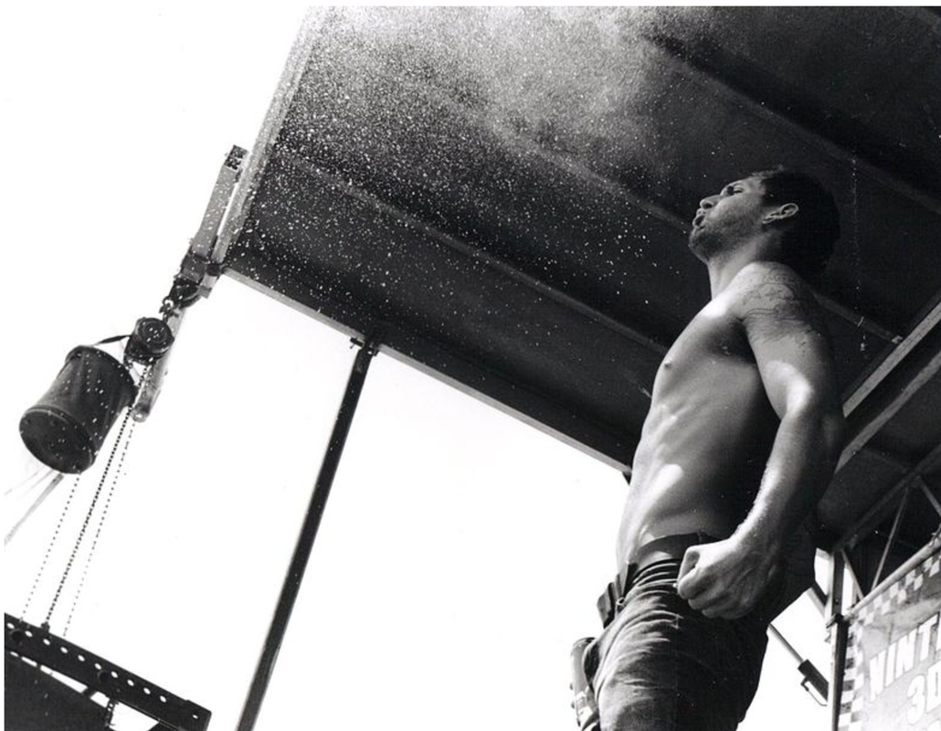

Slide 39
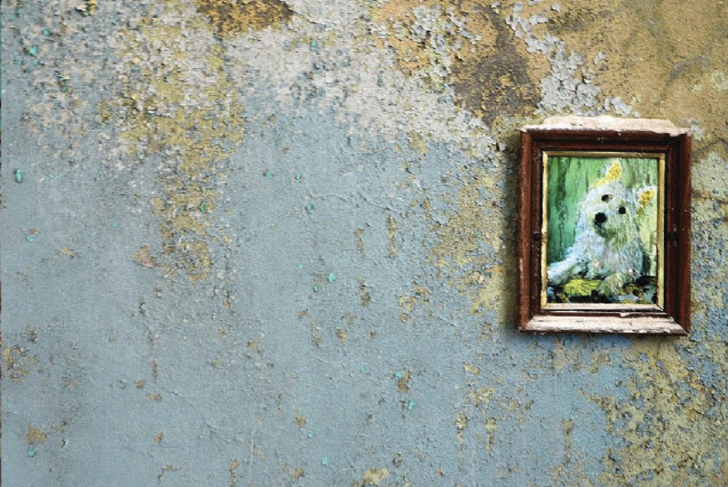

Slide 40
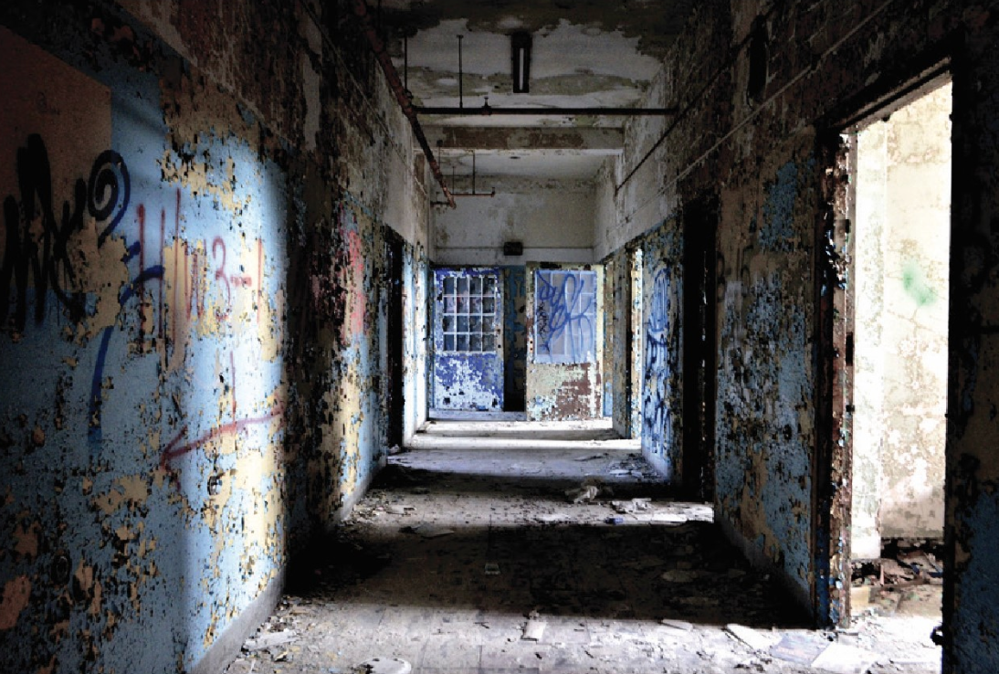

Slide 41
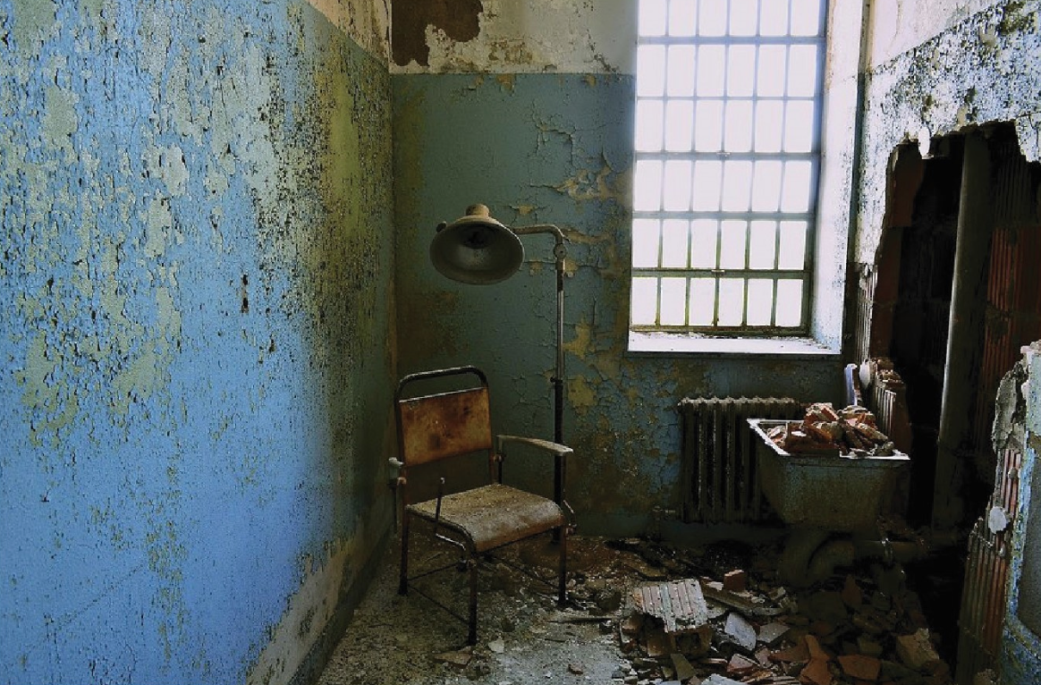

Slide 42
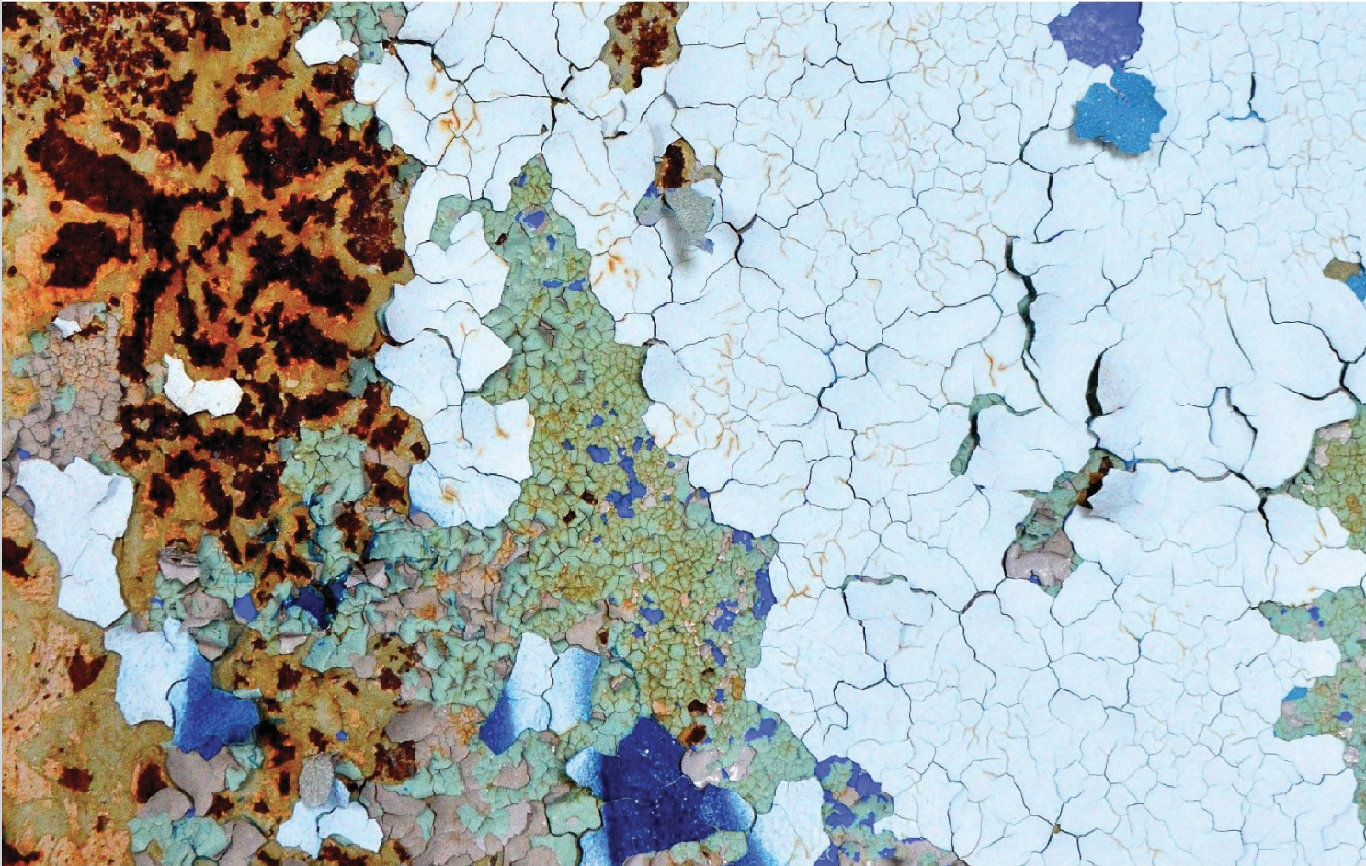

Slide 45
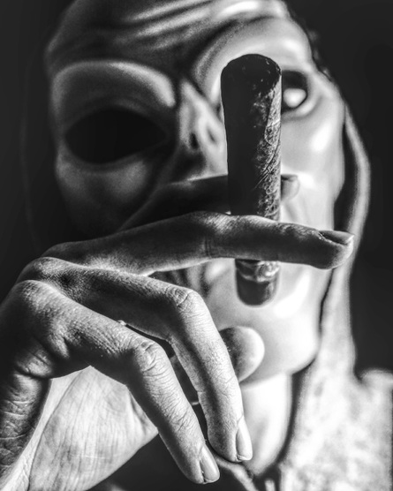

Slide 46
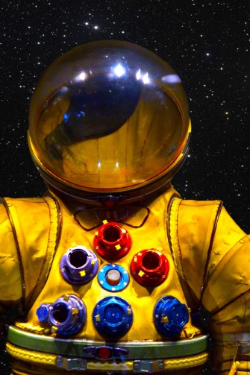

Slide 47
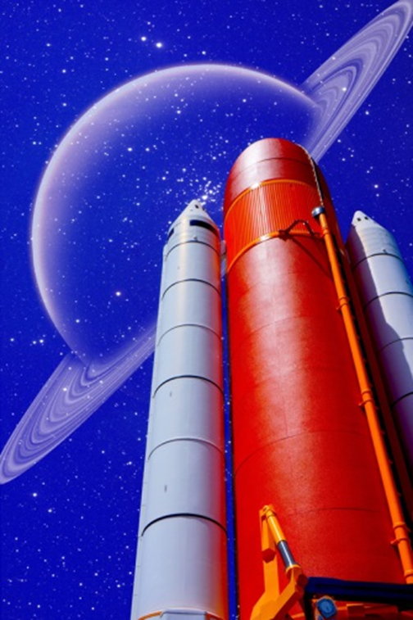

Slide 48
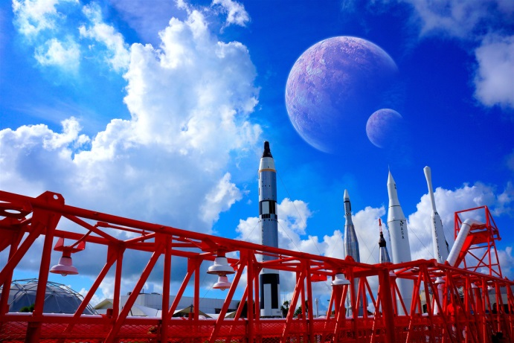

Slide 49
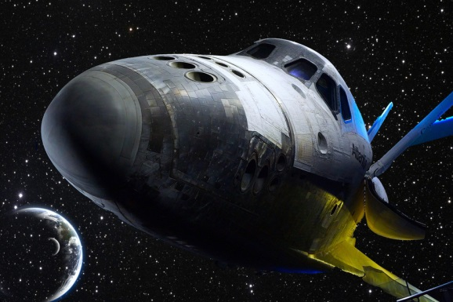

Slide 50
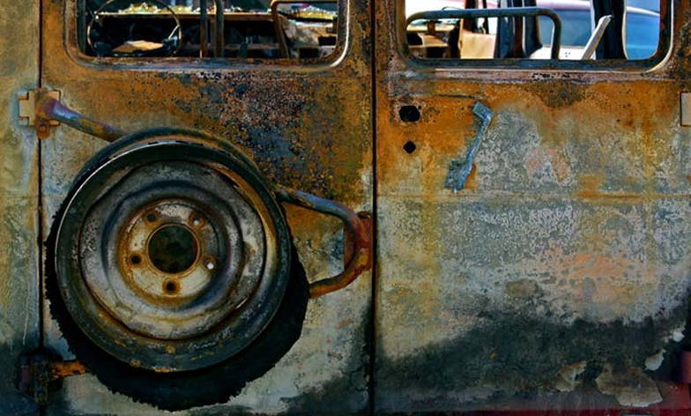

Slide 53
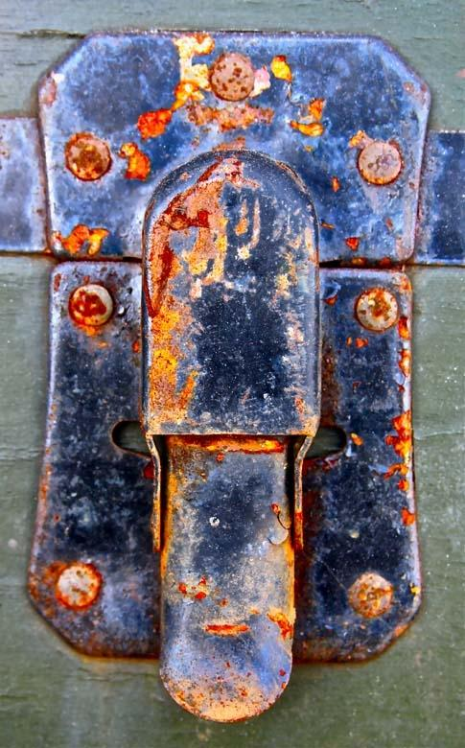

Slide 56
Sculpture

Slide 57
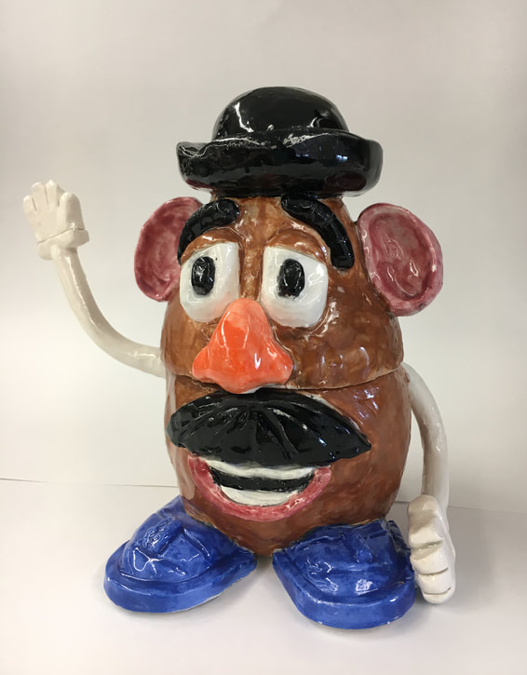
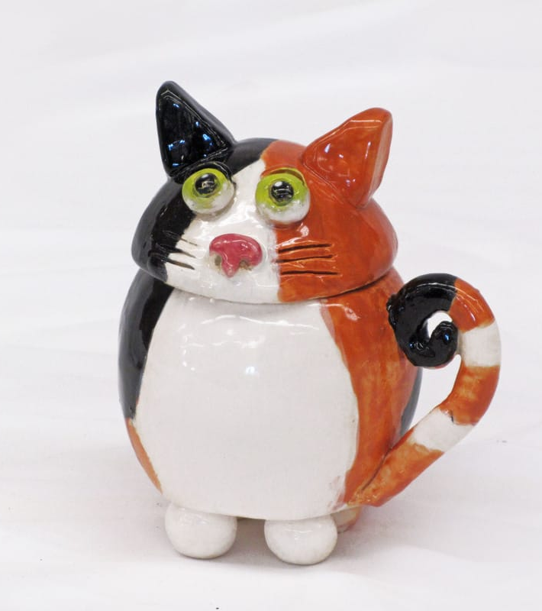

Slide 58
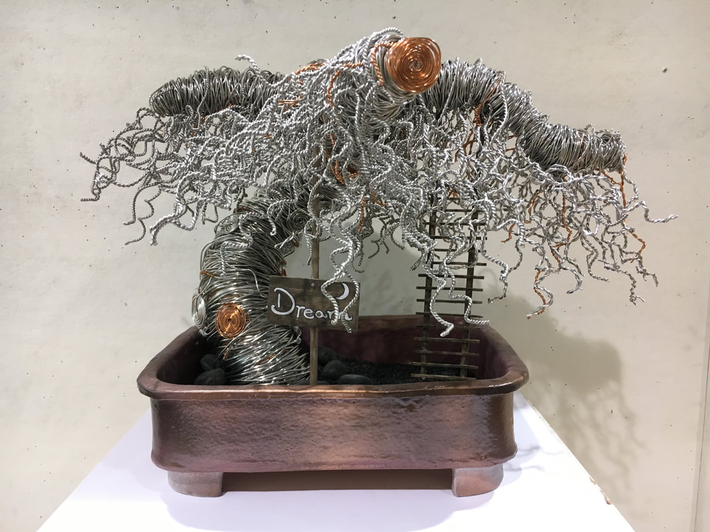

Slide 59
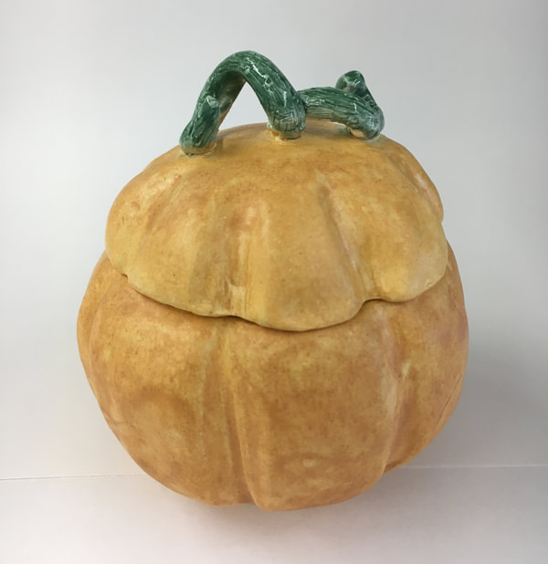

Slide 60
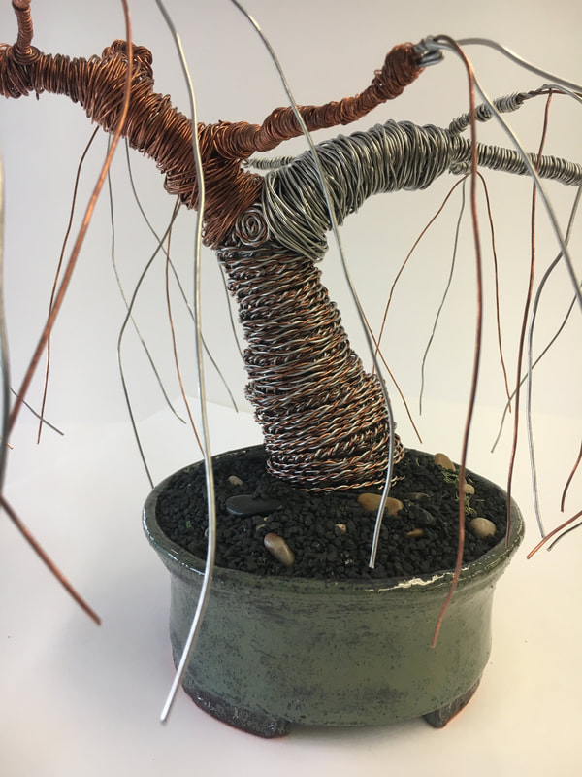

Slide 61
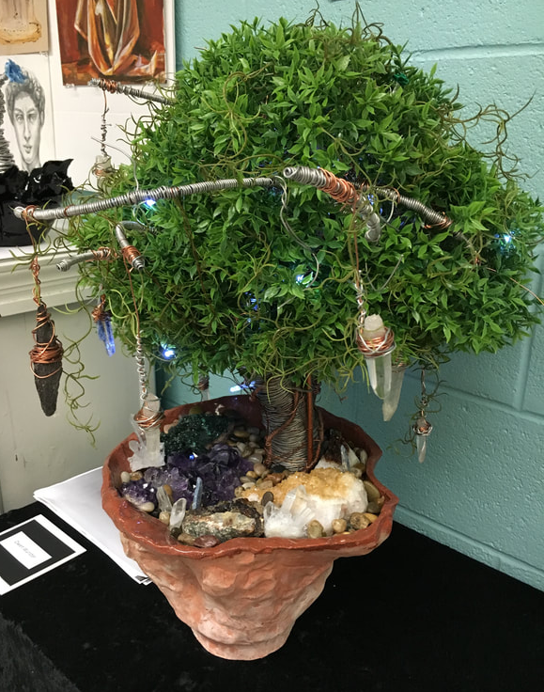

Slide 62
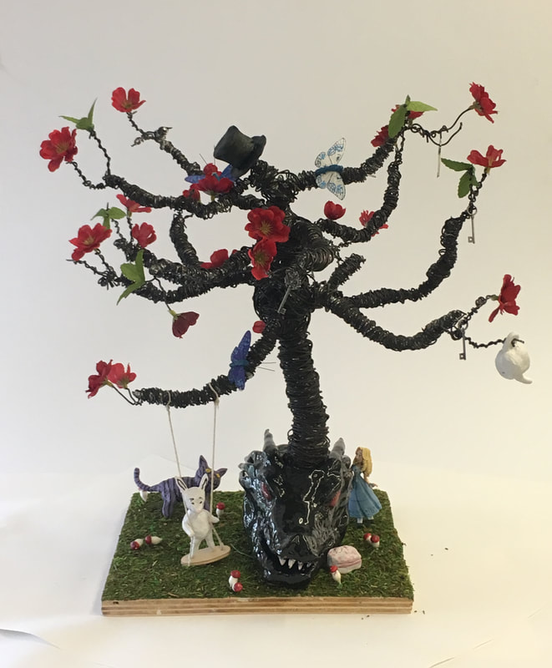

Slide 96
Creative Suite

